Slide 1
Week 11
System Implementation

Slide 2
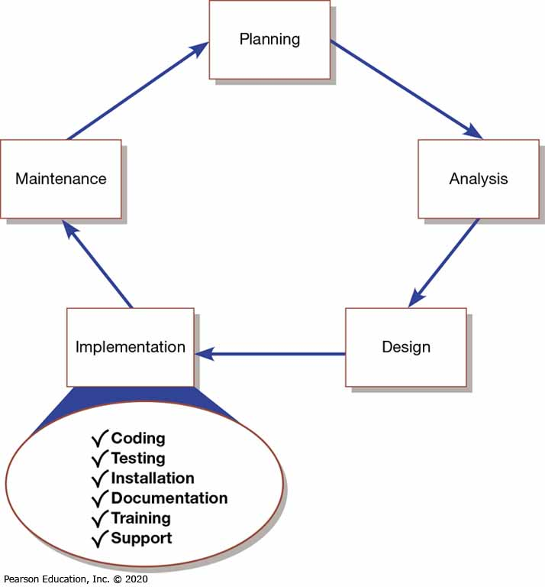
Figure 1: Systems Development Life Cycle with the Implementation Phase Highlighted

Slide 3
System Implementation
Purpose:
  To convert final physical system specifications into working and reliable software
  To document work that has been done
  To provide help for current and future users

Slide 4
Table 1: Deliverables for Coding, Testing, and Installation
Coding
  Code
  Program documentation
Testing
  Test scenarios (test plan) and test data
  Results of program and system testing
Installation
  User guides
  User training plan
  Installation and conversion plan
    Software and hardware installation schedule
    Data conversion plan
    Site and facility remodeling plan

Slide 5
Documenting the System, Training Users, and Supporting Users
Two audiences for final documentation:
  Information systems personnel who will maintain the system throughout its productive life
  People who will use the system as part of their daily lives
User Training
  Application-specific
  General for operating system and off-the-shelf software

Slide 6
Table 2: Deliverables for Documenting the System, Training and Supporting Users
Documentation
  System documentation
  User documentation
User training plan
  Classes
  Tutorials
User training modules
  Training materials
  Computer-based training aids
User support plan
  Help desk
  Online help
  Bulletin boards and other support mechanisms

Slide 7
Software Application Testing
A master test plan is developed during the analysis phase
During the design phase, unit, system and integration test plans are developed
The actual testing is done during implementation
Written test plans provide improved communication among all parties involved in testing

Slide 8
Table 3: Table of Contents of a Master Test Plan (1 of 3)
Introduction
  Description of system to be tested
  Objectives of the test plan
  Method of testing
  Supporting documents
Overall Plan
  Milestones, schedules, and locations
  Test materials
    Test plans
    Test cases
    Test scenarios
    Test log

Slide 9
Table 3: Table of Contents of a Master Test Plan (2 of 3)
Testing Requirements
  Hardware
  Software
  Personnel
Procedure Control
  Test initiation
  Test execution
  Test failure
  Access/change control
  Document control

Slide 10
Table 3: Table of Contents of a Master Test Plan (3 of 3)
Test-specific or component-specific test plans
  Objectives
  Software description
  Method
  Milestones, schedule, progression
  Locations
  Requirements
  Criteria for passing tests
  Resulting test materials
  Execution control
  Attachments
(Source: Adapted from Mosley, 1993.)

Slide 11
Seven Different Types of Tests (1 of 4)
Software application testing is an umbrella term that covers several types of tests
Static or dynamic techniques
  Static testing means that the code being tested is not executed
  Dynamic testing involves execution of the code
Automated testing vs. manual testing
  Automated means computer conducts the test
  Manual means that people complete the test

Slide 12
Table 4: Categorization of Test Types
.. | Manual | Automated
Static | Inspections | Syntax checking
Dynamic | Walk-through Desk checking | Unit test Integration test System test
(Source: Adapted from Mosley, 1993)

Slide 13
Seven Different Types of Tests (2 of 4)
Seven types of testing:
  Inspections – testing technique in which participants examine program code for predictable language-specific errors
  Walk-throughs (code walk-throughs) should be done frequently when pieces of work are reviewed and before formal testing. It is an informal process.

Slide 14
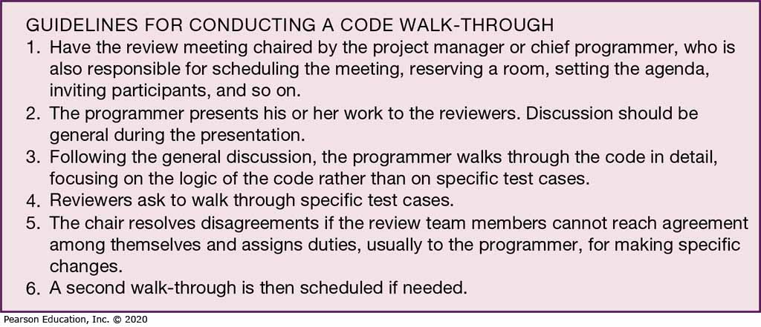
Figure 2: Steps in a Typical Walk-Through
(Source: Based on Yourdon, 1989)

Slide 15
Seven Different Types of Tests (3 of 4)
Seven types of testing:
  Desk checking – testing technique in which the program code is sequentially executed manually by the reviewer
  Unit testing – process of testing each module alone in an attempt to discover any errors in its code
  Integration testing – process of bringing together all of the modules that a program comprises for testing purposes. Modules are typically integrated in a top-down, incremental fashion.

Slide 16
Seven Different Types of Tests (4 of 4)
Seven types of testing:
  System testing – bringing together of all of the programs that a system comprises for testing purposes. Programs are typically integrated in a top-down, incremental fashion.
  Stub testing – technique used in testing modules, especially where modules are written and tested in a top-down fashion, where a few lines of code are used to substitute for subordinate modules

Slide 17
The Testing Process (1 of 2)
Two important things to remember when testing information systems:
  The purpose of testing is to confirm that the system satisfies requirements
  Testing must be planned
A test case is a specific scenario of transactions, queries, or navigation paths that represent a typical, critical, or abnormal use of the system
  Should be repeatable
  Need to determine if new software work with other existing software

Slide 18
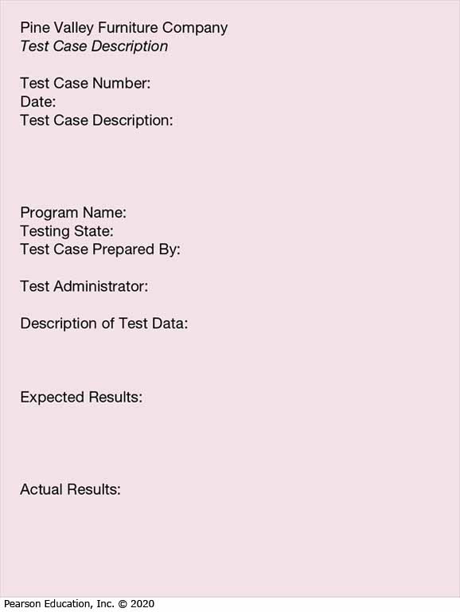
Figure 3: Test Case Description Form
(Source: Adapted from Mosley, 1993)

Slide 19
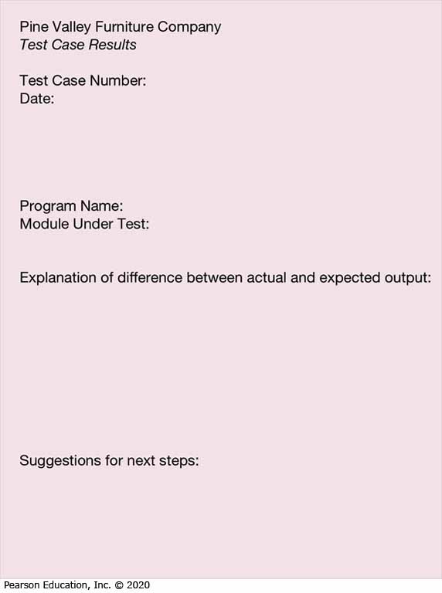
Figure 4: Test Case Results Form
(Source: Adapted from Mosley, 1993)

Slide 20
The Testing Process (2 of 2)
Testing harness – automated testing environment used to review code for errors, standards violations, and other design flaws
  Greatly enhances the testing process because it can automatically expand the scope of the tests beyond the current development platform

Slide 21
Acceptance Testing by Users (1 of 2)
Acceptance testing – process whereby actual users test a completed information system, the end result of which is the users’ acceptance of it
Alpha testing – user testing of a completed information system using simulated data
Beta testing – user testing of a completed information system using real data in the real user environment

Slide 22
Installation
Installation – organizational process of changing over from the current information system to a new one
Four installation strategies:
  Direct installation
  Parallel installation
  Single-location installation
  Phased installation

Slide 23
Installation
Direct installation – changing over from the old information system to a new one by turning off the old system when the new one is turned on
  Users at the mercy of the new system
  Very risky installation
  Least expensive installation

Slide 24
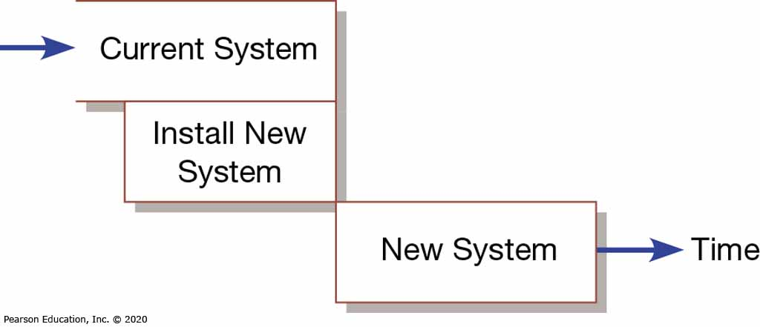
Figure 5: Comparison of Installation Strategies (a) Direct Installation
(Source: Adapted from Bell and Evans, 1989)

Slide 25
Installation (3 of 9)
Parallel installation – running the old information system and the new one at the same time until management decides the old system can be turned off
  Safest approach but very expensive
  Outputs are compared with each system

Slide 26
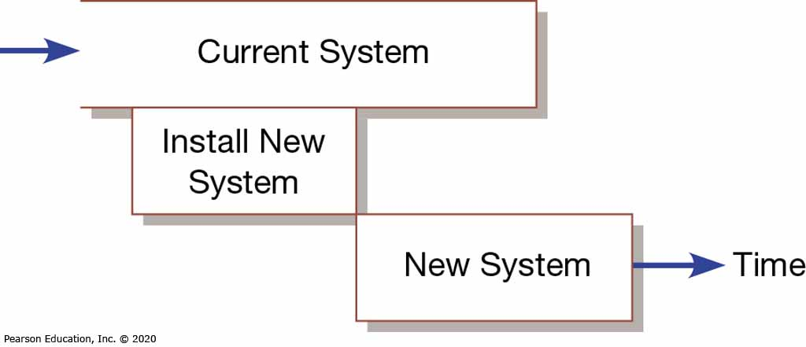
Figure 5: Comparison of Installation Strategies (b) Parallel Installation
(Source: Adapted from Bell and Evans, 1989)

Slide 27
Installation
13.3 Apply four installation strategies: direct, parallel, single-location, and phased installation
Single-location installation – trying out a new information system at one site and using the experience to decide if and how the new system should be deployed throughout the organization
  Considered a middle-or-the-road approach
  Usually a branch office or one department
  Once successful then rolled out to entire company
  Results in extra work for staff

Slide 28
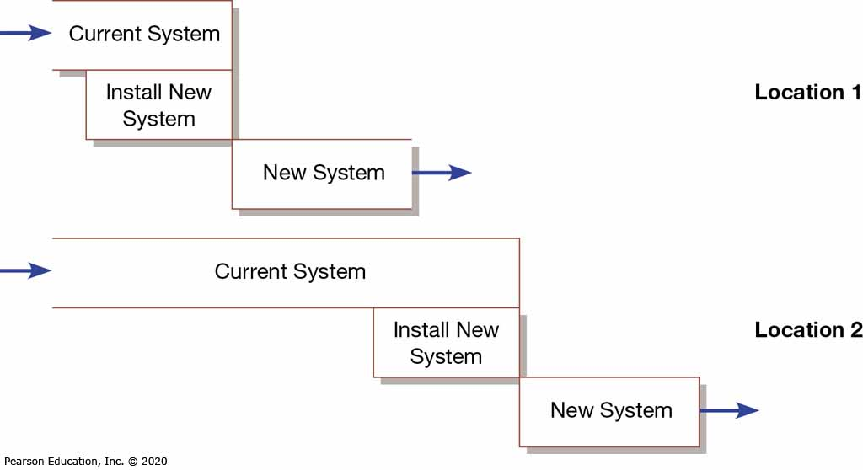
Figure 5: Comparison of Installation Strategies (c) Single-Location Installation (with Direct Installation at Each Location)
(Source: Adapted from Bell and Evans, 1989)

Slide 29
Installation
Phased installation – changing from the old information system to the new one incrementally, starting with one or a few functional components and then gradually extending the installation to cover the whole new system
  An incremental approach (also called staged)
  Usually implemented in a sequence approach
  Requires careful version control

Slide 30
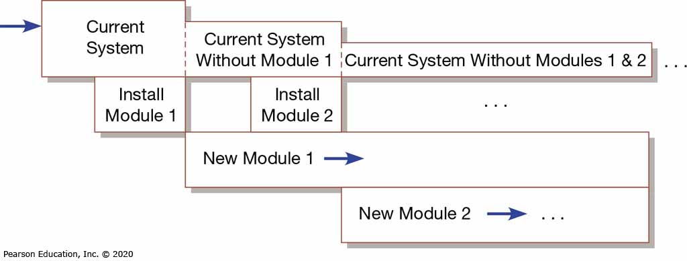
Figure 5: Comparison of Installation Strategies (d) Phased Installation
(Source: Adapted from Bell and Evans, 1989)

Slide 31
Planning Installation
13.3 Apply four installation strategies: direct, parallel, single-location, and phased installation
Of special interest during installation is the conversion of data
  Must be error free, combined with new data and loaded into files
  May require current systems to be shut down
  Involves getting people to change the way they work

Slide 32
Documenting the System
System documentation – detailed information about a system’s design specifications, its internal workings, and its functionality
User documentation – written or other visual information about an application system, how it works, and how to use it

Slide 33
Training and Supporting Users
Support – providing ongoing educational and problem-solving assistance to information system users. For in-house developed systems, support materials and jobs will have to be prepared or designed as part of the implementation process.

Slide 34
Table 7: Types of Training
Resident expert
Traditional instructor-led classroom training
E-learning/distance learning
Blended learning (combination of instructor-led and e-learning)
Software help components
External sources, such as vendors

Slide 35
Automating Support
Vendor’s have automated support to users in order to cut costs
Ways vendor’s have automated support:
  Forums offered over the Internet
  Voice-response systems allow users to navigate option menus
  Vendor knowledge bases
Help desk – single point of contact for all user inquiries and problems about a particular information system or for all users in a particular department (non automated)

Slide 36
Organizational Issues in Systems Implementation
Implementation effort sometimes fails because:
  Employees don’t use the new system
  Employee dissatisfaction with new system
Important factors to implementation success include:
  Commitment to the project
  Commitment to change (willingness to change behaviors)
  Meeting user expectations

Slide 37
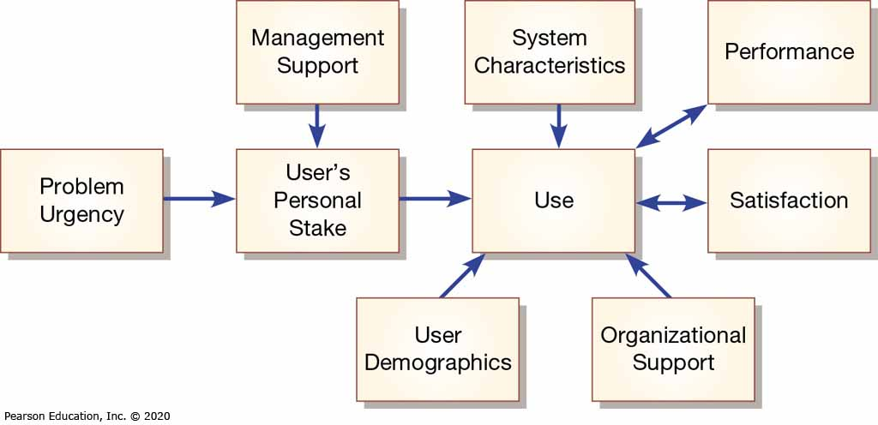
Figure 9: Implementation success
(Source: From Lucas, H. C. (1997). Information technology for management. New York: McGraw-Hill. Reprinted by
permission.)

